Slide 1
Chapter 10: Storage and File Structure Self Reading Slides: 1 to 19 Before Midsem: 1-19, 52 Onwards After Midsem: 31-51
Notes:
‹#›

Slide 2
Major Goals
To understand DBMS
Storage management
Disk-based data organization for efficient data access
Indexes
Buffer management

Slide 3
Chapter 10: Storage and File Structure
Overview of Physical Storage Media
Magnetic Disks
RAID
Tertiary Storage
Storage Access
File Organization
Organization of Records in Files
Data-Dictionary Storage
Notes:
‹#›

Slide 4
Classification of Physical Storage Media
Speed with which data can be accessed
Cost per unit of data
Reliability
Data loss on power failure or system crash
Physical failure of the storage device
Can differentiate storage into
Volatile storage
Loses contents when power is switched off
Non-volatile storage
Contents persist even when power is switched off
Includes secondary and tertiary storage, as well as batter- backed up main-memory
Notes:
‹#›

Slide 5
Physical Storage Media
Cache
Fastest and most costly form of storage; volatile; managed by the computer system hardware
Main memory
Fast access (10s to 100s of nanoseconds; 1 nanosecond = 10^{–9} seconds)
Generally too small (or too expensive) to store the entire database
Capacities of up to a few Gigabytes widely used currently
Capacities have gone up and per-byte costs have decreased steadily and rapidly (roughly factor of 2 every 2 to 3 years)
Volatile — Contents of main memory are usually lost if a power failure or system crash occurs
Notes:
‹#›

Slide 6
Physical Storage Media (Cont.)
Flash memory
Data survives power failure
Data can be written at a location only once, but location can be erased and written to again
Can support only a limited number (10K – 1M) of write/erase cycles.
Erasing of memory has to be done to an entire bank of memory
Reads are roughly as fast as main memory
But writes are slow (few microseconds), erase is slower
Widely used in embedded devices such as digital cameras, phones, and USB keys
Notes:
‹#›

Slide 7
Physical Storage Media (Cont.)
Magnetic-disk
Data is stored on spinning disk, and read/written magnetically
Primary medium for the long-term storage of data; typically stores entire database.
Data must be moved from disk to main memory for access, and written back for storage
Much slower access than main memory (more on this later)
Direct-access – possible to read data on disk in any order, unlike magnetic tape
Capacities range up to roughly 1.5 TB as of 2009
Much larger capacity and cost/byte than main memory/flash memory
Growing constantly and rapidly with technology improvements (factor of 2 to 3 every 2 years)
Survives power failures and system crashes
disk failure can destroy data, but is rare
Notes:
‹#›

Slide 8
Physical Storage Media (Cont.)
Optical storage
Non-volatile, data is read optically from a spinning disk using a laser
CD-ROM (640 MB) and DVD (4.7 to 17 GB) most popular forms
Blu-ray disks: 27 GB to 54 GB
Write-one, read-many (WORM) optical disks used for archival storage (CD-R, DVD-R, DVD+R)
Multiple write versions also available (CD-RW, DVD-RW, DVD+RW, and DVD-RAM)
Reads and writes are slower than with magnetic disk
Juke-box systems, with large numbers of removable disks, a few drives, and a mechanism for automatic loading/unloading of disks available for storing large volumes of data
Notes:
‹#›

Slide 9
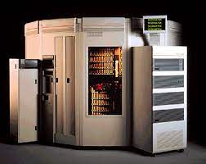
Physical Storage Media (Cont.)
Tape storage
Non-volatile, used primarily for backup (to recover from disk failure), and for archival data
Sequential-access – much slower than disk
Very high capacity (40 to 300 GB tapes available)
Tape can be removed from drive ⇒ storage costs much cheaper than disk, but drives are expensive
Tape jukeboxes available for storing massive amounts of data
Hundreds of terabytes (1 terabyte = 10⁹ bytes) to even multiple petabytes (1 petabyte = 10¹² bytes)
Notes:
‹#›

Slide 10
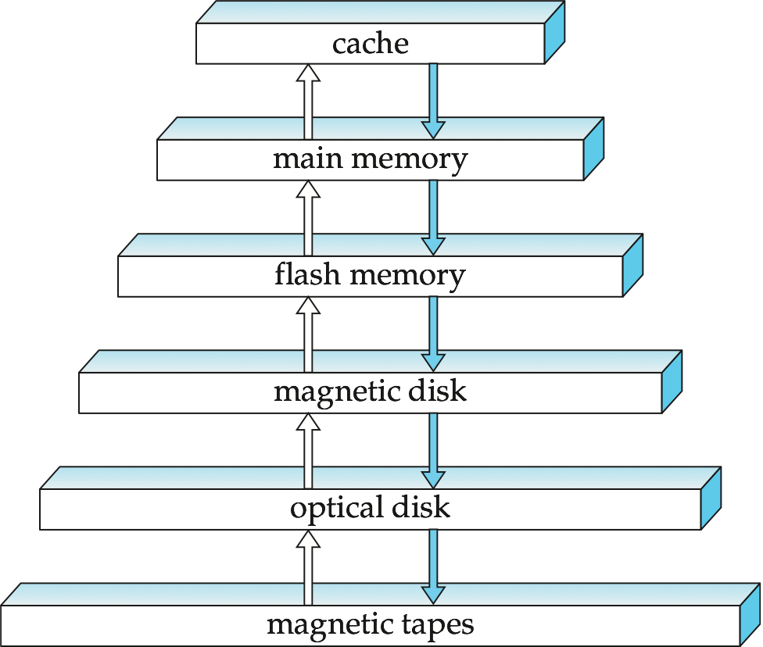
Storage Hierarchy
Notes:
‹#›

Slide 11
Storage Hierarchy (Cont.)
Primary storage: Fastest media but volatile (cache, main memory)
Secondary storage: Next level in hierarchy, non-volatile, moderately fast access time
Also called on-line storage
E.g. flash memory, magnetic disks
Tertiary storage: Lowest level in hierarchy, non-volatile, slow access time
Also called off-line storage
E.g. magnetic tape, optical storage
Notes:
‹#›

Slide 12
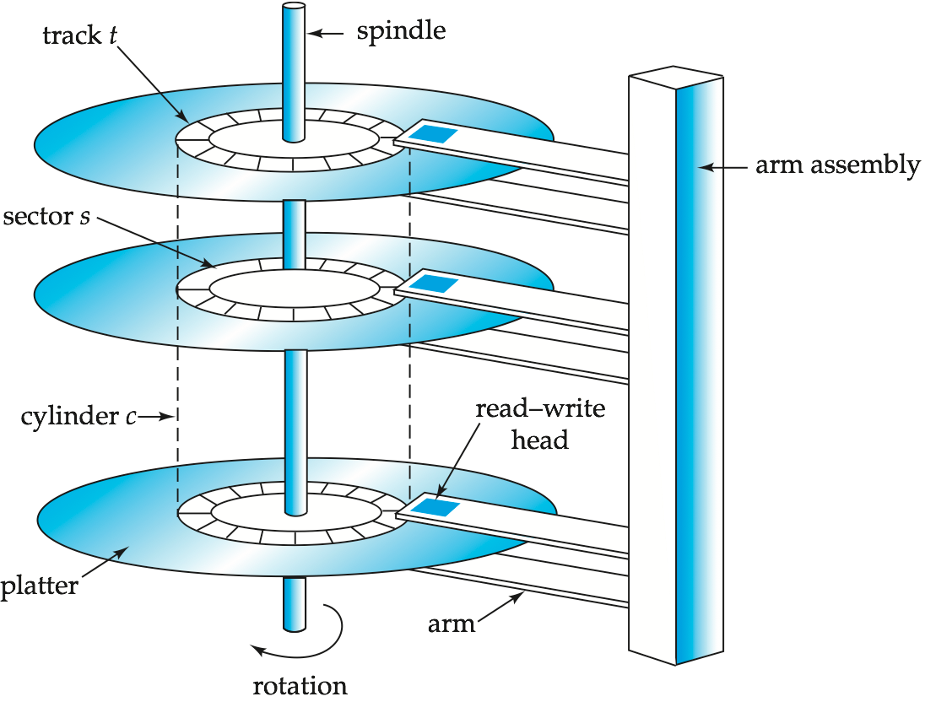
Magnetic Hard Disk Mechanism
NOTE: Diagram is schematic, and simplifies the structure of actual disk drives
Notes:
‹#›

Slide 13
Magnetic Disks
Read-write head
Positioned very close to the platter surface (almost touching it)
Reads or writes magnetically encoded information
Surface of platter divided into circular tracks
Over 50K-100K tracks per platter on typical hard disks
Each track is divided into sectors
A sector is the smallest unit of data that can be read or written
Sector size typically 512 bytes
Typical sectors per track: 500 to 1000 (on inner tracks) to 1000 to 2000 (on outer tracks)
To read/write a sector
Disk arm swings to position head on right track
Platter spins continually; data is read/written as sector passes under head
Head-disk assemblies
Multiple disk platters on a single spindle (1 to 5 usually)
One head per platter, mounted on a common arm
Cylinder i consists of i^{th} track of all the platters
Notes:
‹#›

Slide 14
Magnetic Disks (Cont.)
Earlier generation disks were susceptible to head-crashes
Surface of earlier generation disks had metal-oxide coatings which would disintegrate on head crash and damage all data on disk
Current generation disks are less susceptible to such disastrous failures, although individual sectors may get corrupted
Disk controller – interfaces between the computer system and the disk drive hardware
Accepts high-level commands to read or write a sector
Initiates actions such as moving the disk arm to the right track and actually reading or writing the data
Computes and attaches checksums to each sector to verify that data is read back correctly
If data is corrupted, with very high probability stored checksum won’t match recomputed checksum
Ensures successful writing by reading back sector after writing it
Performs remapping of bad sectors
Notes:
‹#›

Slide 15
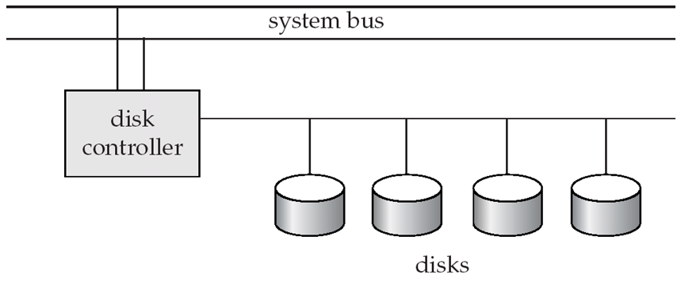
Disk Subsystem
Multiple disks connected to a computer system through a controller
Controllers functionality (checksum, bad sector remapping) often carried out by individual disks; reduces load on controller
Disk interface standards families
ATA (AT adaptor) range of standards
SATA (Serial ATA)
SCSI (Small Computer System Interconnect) range of standards
SAS (Serial Attached SCSI)
Several variants of each standard (different speeds and capabilities)
Notes:
‹#›

Slide 16
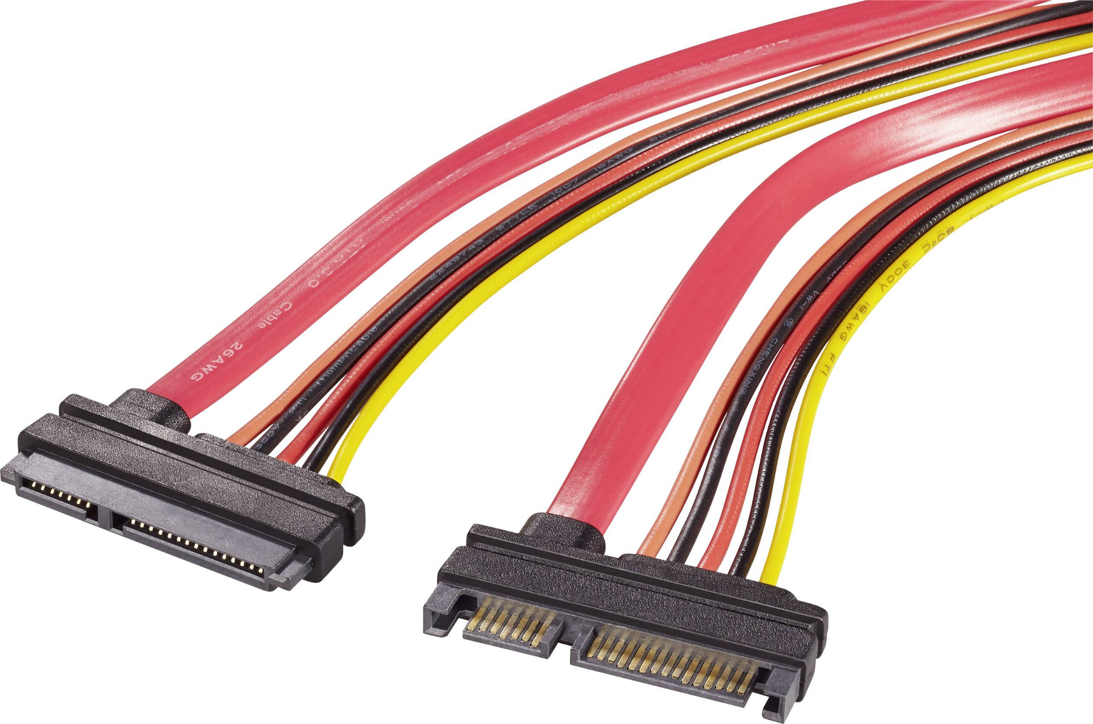

SATA(ATA)(serial advanced technology attachment)
An interface for transferring data between a computer's central circuit board and storage devices.

Slide 17
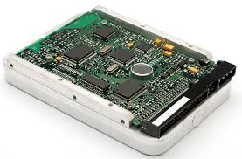
SCSI (Small Computer System Interface)
A set of standards for physically connecting and transferring data between computers and peripheral devices
SCSI Devices
Hard drives, scanners, printers, and other peripherals

Slide 18

S
SAS(serial attached SCSI)
That moves data to and from computer-storage devices such as hard disk drives and tape drives

Slide 19
Disk Subsystem
Disks usually connected directly to computer system
Storage Area Networks (SAN)
A large number of disks are connected by a high-speed network to a number of servers
Network Attached Storage (NAS)
Networked storage provides a file system interface using networked file system protocol, instead of providing a disk system interface

Slide 20
Performance Measures of Disks
Access time
The time it takes from when a read or write request is issued to when data transfer begins
Consists of:
Seek time – time it takes to reposition the arm over the correct track
Average seek time is 1/2 the worst case seek time
Would be 1/3 if all tracks had the same number of sectors, and we ignore the time to start and stop arm movement
4 to 10 milliseconds on typical disks
Rotational latency – time it takes for the sector to be accessed to appear under the head
Average latency is 1/2 of the worst case latency
4 to 11 milliseconds on typical disks (5400 to 15000 r.p.m.)
Notes:
‹#›

Slide 21
Performance Measures of Disks
Data-transfer rate
The rate at which data can be retrieved from or stored to the disk
25 to 100 MB per second max rate, lower for inner tracks
Multiple disks may share a controller, so rate that controller can handle is also important
E.g. SATA: 150 MB/sec, SATA-II 3Gb (300 MB/sec)
Ultra 320 SCSI: 320 MB/s, SAS (3 to 6 Gb/sec)
Fiber Channel (FC2Gb or 4Gb): 256 to 512 MB/s
Notes:
‹#›

Slide 22
Performance Measures (Cont.)
Mean time to failure (MTTF)
The average time the disk is expected to run continuously without any failure
Typically 3 to 5 years
Probability of failure of new disks is quite low, corresponding to a “theoretical MTTF” of 500,000 to 1,200,000 hours for a new disk
E.g., an MTTF of 1,200,000 hours for a new disk means that given 1000 relatively new disks, on an average one will fail every 1200 hours
MTTF decreases as disk ages
Notes:
‹#›

Slide 23
Disk Access
On read from / write to the disk
Request for disk I/O generated from OS by
File system and by the Virtual Memory manager
Request specifies the Address on the disk to be referenced, as
Block number
Block – Logical unit of a fixed number of contiguous sequence of sectors from a single track
Data is transferred between disk and main memory in blocks
Sizes range from 512 bytes to several kilobytes
Smaller blocks: more transfers from disk
Larger blocks : more space wasted due to partially filled blocks
Typical block sizes today range from 4 to 16 kilobytes
Notes:
‹#›

Slide 24
Random Approach
0 | f1
1 | f2
2 | f3
3 | f1
4 | f2
5 | f1
..
..
99

Slide 25
Disk-Block Access
Sequence of requests of blocks from disk, classified as
Sequential Access
Successive block numbers requests are for blocks on the SAME or on ADJACENT TRACK
Disk seek required for the first block, but successive requests either not require a seek, or require a seek to an adjacent track
Faster than a seek to a track that is farther away
Random Access
Transfer rate is significantly lower than the sequential access
Successive requests are for blocks that are randomly located on the disk
Each such request require a seek
The number of random block accesses that can be satisfied by a single disk in a second depends on the seek time
Typically around 100 to 200 accesses per second
As only a small amount of data is read per seek
Notes:
‹#›

Slide 26
Optimization of Disk-Block Access
Techniques to improve the speed of access to blocks
Buffering
Read-Ahead
Scheduling
File organization
Nonvolatile Write Buffers
Log disk
Notes:
‹#›

Slide 27
Optimization of Disk-Block Access
Techniques to improve the speed of access to blocks
1. Buffering
Blocks from disk are read in main memory buffer, to satisfy future requests
Done by both the Operating system and DBMS
2. Read-Ahead
On disk block access, consecutive blocks from the same track are read into an in-memory buffer even if there is no pending request for the blocks
If sequential access, then many blocks are ready in memory when they are requested and minimizes the disk seeks and rotational latency per block read
If random access, then not very useful
Notes:
‹#›

Slide 28
Optimization of Disk-Block Access
3. Scheduling
If several blocks from a cylinder to be read from disk to main memory, then it save access time, if requesting blocks in the order in which they will pass under the heads
If the desired blocks are on different cylinders, it is advantageous to request the pending blocks in an order that minimizes the disk-arm movement
Disk-Arm Scheduling Algorithm
Order the access to tracks to increase the number of accesses that can be processed
Elevator algorithm
Notes:
‹#›

Slide 29
Optimization of Disk-Block Access
Disk-Arm Scheduling Algorithm
Order the access of tracks to increase the number of accesses that can be processed
Elevator algorithm
The arm is moving from innermost track toward the outside of the disk
During this, serve the access request
And continue till the farther out
Then change the direction and continue
Disk controllers reorders the read requests
Based on the organization of block on disk, of the rotational position of the disk platters and of the position of the disk-arm
R6
R3
R1
R5
R2
R4
Inner track
Outer track
Notes:
‹#›

Slide 30
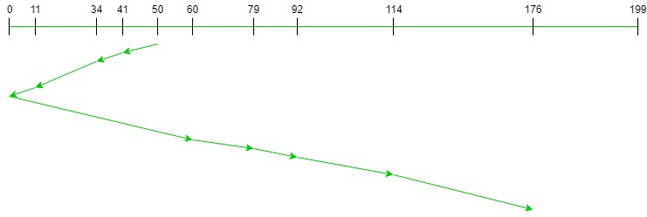
Elevator Algorithm
Input:
Request sequence = {176, 79, 34, 60, 92, 11, 41, 114}
Initial head position = 50
Direction = left (We are moving from right to left)
Output:
Total number of seek operations = 226
Seek Sequence is
41
34
11
0
60
79
92
114
176

Slide 31
Optimization of Disk Block Access (Cont.)
4. File organization
Optimize block access time by organizing the blocks correspond to how data will be accessed
i.e. Store related information on the same or nearby cylinders
Sequentially accessed file
Files may get fragmented over time
E.g. if data is inserted to/deleted from the file
Or free blocks on disk are scattered, and newly created file has its blocks scattered over the disk
Sequential access to a fragmented file results in increased disk arm movement
Some systems have utilities to defragment the file system, in order to speed up file access
Notes:
‹#›

Slide 32
Optimization of Disk Block Access (Cont.)
5. Nonvolatile Write Buffers
Main memory content lost on power failure
Database updates has to be recorded on disk to survive possible system crashes
Non-Volatile RAM (NVRAM)
Speeds up disk writes by writing blocks to a NVRAM buffer immediately
Battery backed up RAM or flash memory
Even if power fails, the data is safe and will be written to disk when power returns
Notes:
‹#›

Slide 33
Optimization of Disk Block Access (Cont.)
Non-Volatile RAM (NVRAM)
Database operations that require data to be safely stored before continuing can continue without waiting for data to be written to disk
Controller writes to disk whenever
The disk has no other requests / Pending request for some time
The NVRAM buffer becomes full
Found in RAID Controllers (Later)
Notes:
‹#›

Slide 34
Optimization of Disk Block Access (Cont.)
6. Log disk
Another approach to reduce write latency
A disk devoted to writing a sequential log of block updates
Write to log disk is very fast as number of blocks at a time
Writes can be reordered to minimize disk arm movement
On system crashes before some writes to the actual disk location have completed, when the system comes back up it reads the log disk to find those writes that had not been completed and carries out them out then
Notes:
‹#›

Slide 35
Optimization of Disk Block Access (Cont.)
Log Disk
If no log disk, Risk of corruption of file system data
Old generation file system
Journaling file systems
In modern file system, Log disk requires file systems that support log disks to reorder writes to disk
Write data in safe order log disk
Improves performance, if separate data and log disk
Can be implemented even without a separate log disk
Keep data and the log on the same disk
Reduces the monetary cost at the expense of lower performance
Ch. 16 Recovery system
Notes:
‹#›

Slide 36
Flash Storage
NOR flash
Allows random access to the individual WORDS of memory
NAND flash
Used widely for storage
Since it is much cheaper than NOR flash and higher storage
Requires page-at-a-time read (page: 512 bytes to 4 KB-Approx. sector of mag. disk) into main memory
Transfer rate around 20 MB/sec
Can use multiple flash storage devices to provide higher transfer rate of 100 to 200 MB/sec

Slide 37
Flash Storage
NAND flash
Write
Little more complicated takes few microseconds
Cannot be directly overwritten
Requires first erase and then allowed to write
Erase is very slow (1 to 2 milli secs)
Erase block contains multiple pages (erase block)
Remapping of logical page addresses to physical page addresses avoids waiting for erase
Translation table tracks mapping
Also stored in a label field of flash page
Remapping done by flash translation layer software
Provides Flash storage the identical look as magnetic disk storage to File system and DB Storage
Address mapping: logical to physical
Garbage collection and power off recovery
Wear leveling & bad block management

Slide 38
Flash Storage
NAND flash
Delete
Blocks containing multiple deleted pages are periodically erased
After 100,000 to 1,000,000 erases, erase block becomes unreliable and cannot be used
Wear leveling
Principle of evenly distributing erase operations across physical blocks
Assigns “Cold data” i.e. data that are rarely updated to physical pages that have been erased many times
Assigns “Hot data” i.e. data that are updated frequently to physical pages that have not been erased many times
Done by flash memory controller
Hybrid Disk Drives
Hard disk with combination of Magnetic storage with a smaller amount of flash memory
Flash memory used as a cache for frequently accessed data i.e. rarely updated

Slide 39
RAID
Data storage requirement growing fast so needed a large no. of disks
RAID: Redundant Arrays of Inexpensive Disks
Originally a cost-effective alternative to large, expensive disks as several small cheap disks
I in RAID originally stood for “inexpensive”
Today RAIDs are used for their higher reliability and bandwidth
The “I” is interpreted as independent
RAID: Redundant Arrays of Independent Disks
Disk organization techniques that manage a large numbers of disks, providing a view of a single disk of
High capacity and high speed by using multiple disks in parallel
Improves read/write data rate by allowing independent read/write
High reliability by storing data redundantly on multiple disks
So that data can be recovered even if a disk fails
Notes:
‹#›

Slide 40
RAID
The chance that some disk out of a set of N disks will fail is much higher than the chance that a specific single disk will fail
E.g., a system with 100 disks, each with MTTF of 100,000 hours (approx. 11 years), will have a system MTTF of 1000 hours (approx. 41 days)
Solved the problem of reliability by Redundancy
To avoid data loss are critical with large numbers of disks
Redundancy – store extra information that can be used to rebuild information lost in a disk failure
E.g., Mirroring (or shadowing)
Duplicate every disk
Logical disk consists of two physical disks
Every write is carried out on both disks
Reads can take place from either disk
Notes:
‹#›

Slide 41
Improvement of Reliability via Redundancy
E.g., Mirroring (or shadowing)
If one disk in a pair fails, data still available in the other
Data loss would occur only if a disk fails, and its mirror disk also fails before the system is repaired
Probability of combined event is very small
Except for dependent failure modes such as fire or building collapse or electrical power surges
Mean time to data loss depends on mean time to failure, and mean time to repair
E.g. MTTF of 100,000 hours, mean time to repair of 10 hours gives mean time to data loss of 500*10⁶ hours (or 57,000 years) for a mirrored pair of disks (ignoring dependent failure modes)
Notes:
‹#›

Slide 42
Improvement in Performance via Parallelism
Benefits
The read request rate can be doubled
As the request can be send to either disk
Improve transfer rate by striping data across multiple disks
Bit-level striping – splits bits of each byte across multiple disks
In an array of eight disks, write bit i of each byte to disk i
Each access can read data at eight times the rate of a single disk
Not used much any more
Block-level striping – with n disks, block i of a file goes to disk (i mod n) + 1
e.g. 8 disks, logical block 0 is stored in physical block 0 of disk1, logical block 11 is stored in physical block 1 of disk 4
Requests for different blocks can run in parallel if the blocks reside on different disks
A request for a long sequence of blocks can utilize all disks in parallel
Notes:
‹#›

Slide 43
Improvement in Performance via Parallelism
Two main goals of parallelism in a disk system:
1. Load balance multiple small accesses to increase throughput
2. Parallelize large accesses to reduce response time
Mirroring provides high reliability, but it is expensive
Striping provides high data rates, but does not improve reliability
Solution is PARITY
Memory system uses parity bits for error detection and correction
Each byte in a memory system have a parity bit
To record the no. of bits in the byte that are set to 1 is even parity=0) or odd (parity=1)
If one of the byte gets damaged, the parity of the byte changes and thus will not match the computed parity
Detects only 1-bit errors
 |  |  |  |  |  |  |  | Even Parity | odd parith
1 | 0 | 1 | 1 | 0 | 0 | 1 | 1 | 0 | 1
Notes:
‹#›

Slide 44
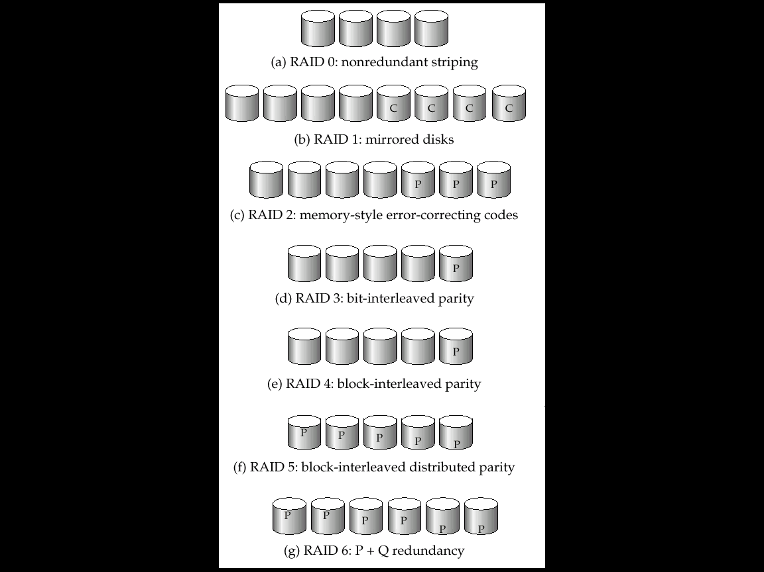
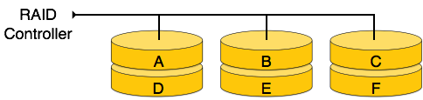
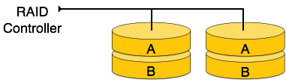
RAID Levels
Schemes to provide redundancy at lower cost by using disk striping combined with parity bits
Different RAID organizations, or RAID levels, have differing cost, performance and reliability characteristics
RAID Level 0: Block striping; non-redundant
Used in high-performance applications where data loss is not critical
RAID Level 1: Mirrored disks with block striping
Offers best write performance
Popular for applications such as storing log files in a database system
For Four disk requires 4 mirror disks (C indicates a 2nd copy of data)
Notes:
‹#›

Slide 45
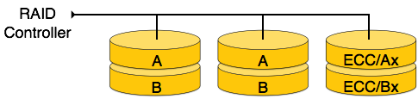
RAID Levels (Cont.)
RAID Level 2: Memory-Style Error-Correcting-Codes (ECC) with bit striping
Parity bits
Memory system uses parity bits for error detection and correction (Hamming Code)
P disk stores error-correcting bits
If one of the disks fails, the remaining bits of the byte and the associated error-correction bits can be read from other disks and can be used to reconstruct the damaged data
For 4 disks, RAID Level 2 requires more 3 disks’ overhead for four disks of data
Notes:
‹#›

Slide 46
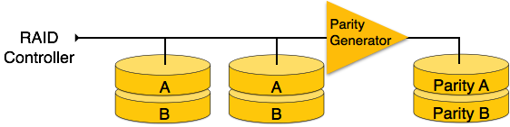
RAID Levels (Cont.)
RAID Level 3: Bit-Interleaved Parity
Uses byte level stripping along with parity
A single parity bit is enough for error correction,
not just detection, since we know which disk has failed
When writing data, corresponding parity bits must also be computed and written to a parity bit disk
To recover data in a damaged disk, compute XOR of bits from other disks (including parity bit disk)
Advantages
Needs only one parity disk for several regular disks
Reduces storage overhead
Reads and writes of a byte are spread out over multiple disks, with N-way striping of data, the transfer rate for reading or writing a single block is N times faster than a RAID level 1
Supports a lower of I/O operations per second
As every disk has to participate in every I/O request
Notes:
‹#›

Slide 47
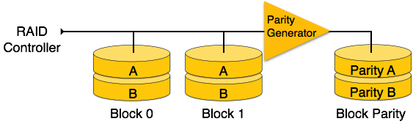
RAID Levels (Cont.)
RAID Level 4: Block-Interleaved Parity; uses block-level striping, and keeps a parity block on a separate disk for corresponding blocks from N other disks
When writing data block, corresponding block of parity bits must also be computed and written to parity disk
To find value of a damaged block, compute XOR of bits from corresponding blocks (including parity block) from other disks
Notes:
‹#›

Slide 48
RAID Levels (Cont.)
RAID Level 4
Provides higher I/O rates for independent block reads than Level 3
Block read goes to a single disk, so blocks stored on different disks can be read in parallel
Provides high transfer rates for reads of multiple blocks than no-striping
Before writing a block, parity data must be computed
Can be done by using old parity block, old value of current block and new value of current block (2 block reads + 2 block writes)
Or by recomputing the parity value using the new values of blocks corresponding to the parity block
More efficient for writing large amounts of data sequentially
Parity block becomes a bottleneck for independent block writes since every block write also writes to parity disk
Notes:
‹#›

Slide 49
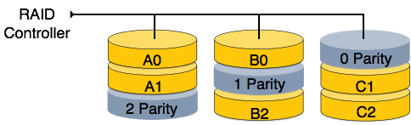
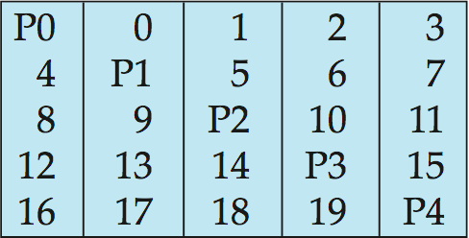
RAID Levels (Cont.)
RAID Level 5: Block-Interleaved Distributed Parity; partitions data and parity among all N + 1 disks, rather than storing data in N disks and parity in 1 disk
E.g., With array of 5 disks, 20 blocks on 5 disks🡺 0 to 4 sets the parity block Pk for logical blocks 4k, 4k+1, 4k+2, 4k+3 is stored in disk k mod 5, i.e.
Parity bit for Block set 0 of Blocks 0, 1, 2, 3 is stored in 0th Disk
Parity bit for Block set 1 of Blocks 4, 5, 6, 7 is stored in 1st Disk
Notes:
‹#›

Slide 50
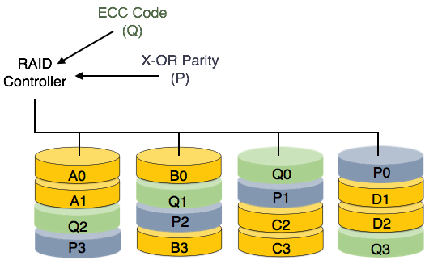
RAID Levels (Cont.)
RAID Level 5
Higher I/O rates than Level 4
Block writes occur in parallel if the blocks and their parity blocks are on different disks
Subsumes Level 4: Provides same benefits, but avoids bottleneck of parity disk
RAID Level 6: P+Q Redundancy scheme; similar to Level 5, but stores double redundant information to guard against multiple disk failures
Better reliability than Level 5 at a higher cost; not used as widely
Notes:
‹#›

Slide 51
Choice of RAID Level
Factors in choosing RAID level
Monetary cost
Performance: Number of I/O operations per second, and bandwidth during normal operation
Performance during failure
Performance during rebuild of failed disk
Including time taken to rebuild failed disk
RAID 0 is used only when data safety is not important
E.g. data can be recovered quickly from other sources
Level 2 and 4 never used since they are subsumed by 3 and 5
Level 3 is not used anymore since bit-striping forces single block reads to access all disks, wasting disk arm movement, which block striping (level 5) avoids
Level 6 is rarely used since levels 1 and 5 offer adequate safety for most applications
Notes:
‹#›

Slide 52
Choice of RAID Level (Cont.)
Level 1 provides much better write performance than level 5
Level 5 requires at least 2 block reads (Data + Parity) and 2 block writes (Data + Parity) to write a single block, whereas Level 1 only requires 2 block writes (Data + Copy)
Level 1 preferred for high update environments such as log disks
Level 1 had higher storage cost than level 5
Disk drive capacities increasing rapidly (50%/year) whereas disk access times have decreased much less (x 3 in 10 years)
I/O requirements have increased greatly, e.g. for Web servers
When enough disks have been bought to satisfy required rate of I/O, they often have spare storage capacity
So there is often no extra monetary cost for Level 1!
Level 5 is preferred for applications with low update rate, and large amounts of data
Level 1 is preferred for all other applications
Notes:
‹#›

Slide 53
RAID Issues
Software RAID: RAID implementations done entirely in software, with no special hardware support
Hardware RAID: RAID implementations with special hardware
Uses non-volatile RAM to record writes that are being executed
Beware: power failure during write can result in corrupted disk
E.g. failure after writing one block but before writing the second in a mirrored system
Such corrupted data must be detected when power is restored
Recovery from corruption is similar to recovery from failed disk
NV-RAM helps to efficiently detected potentially corrupted blocks
Otherwise all blocks of disk must be read and compared with mirror/parity block
Notes:
‹#›

Slide 54
Hardware RAID Issues (Cont.)
Latent failures: Data successfully written earlier gets damaged
Can result in data loss even if only one disk fails
Data scrubbing:
Continually scan for latent failures, and recover from copy/parity
Hot swapping: Replacement of disk while system is running, without power down
Supported by some hardware RAID systems,
Reduces time to recovery, and improves availability greatly
Many systems maintain spare disks which are kept online, and used as replacements for failed disks immediately on detection of failure
Reduces time to recovery greatly
Many hardware RAID systems ensure that a single point of failure will not stop the functioning of the system by using
Redundant power supplies with battery backup
Multiple controllers and multiple interconnections to guard against controller/interconnection failures
Notes:
‹#›

Slide 55
Tertiary Storage-Optical Disks
Compact disk-read only memory (CD-ROM)
Removable disks, 640 MB per disk
Seek time about 100 msec (optical read head is heavier and slower)
Higher latency (3000 RPM) and lower data-transfer rates (3-6 MB/s) compared to magnetic disks
Digital Video Disk (DVD)
DVD-5 holds 4.7 GB , and DVD-9 holds 8.5 GB
DVD-10 and DVD-18 are double sided formats with capacities of 9.4 GB and 17 GB
Blu-ray DVD: 27 GB (54 GB for double sided disk)
Slow seek time, for same reasons as CD-ROM
Record once versions (CD-R and DVD-R) are popular
data can only be written once, and cannot be erased.
high capacity and long lifetime; used for archival storage
Multi-write versions (CD-RW, DVD-RW, DVD+RW and DVD-RAM) also available
Notes:
‹#›

Slide 56
Tertiary Storage-Magnetic Tapes
Hold large volumes of data and provide high transfer rates
Few GB for DAT (Digital Audio Tape) format, 10-40 GB with DLT (Digital Linear Tape) format, 100 GB+ with Ultrium format, and 330 GB with Ampex helical scan format
Transfer rates from few to 10s of MB/s
Tapes are cheap, but cost of drives is very high
Very slow access time in comparison to magnetic and optical disks
limited to sequential access.
Some formats (Accelis) provide faster seek (10s of seconds) at cost of lower capacity
Used mainly for backup, for storage of infrequently used information, and as an off-line medium for transferring information from one system to another.
Tape jukeboxes used for very large capacity storage
Multiple petabyes (10¹⁵ bytes)
Notes:
‹#›

Slide 57
File Organization, Record Organization and Storage Access
DBMS manages the data at physical level
How to store entities and their relations
Separate Entity & Relations or Together Entity and Relations

Slide 58
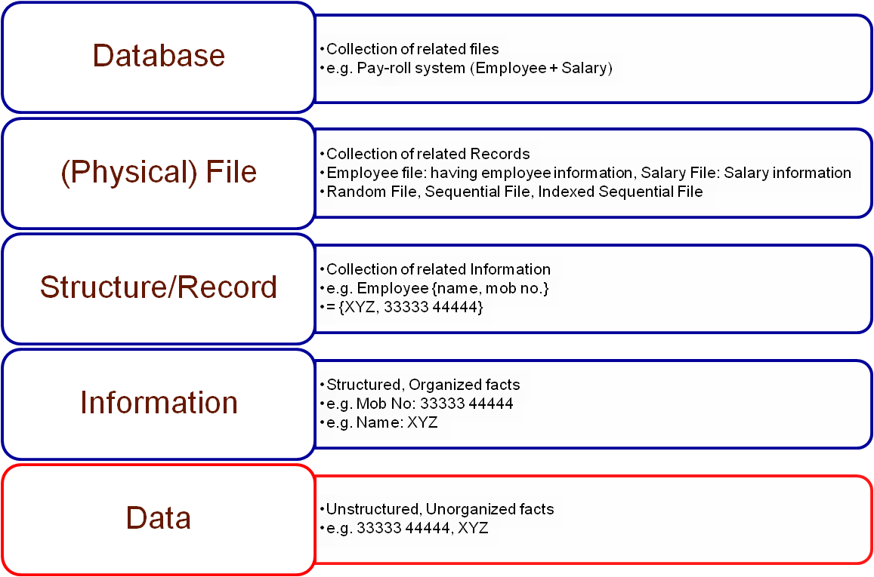
Data Storage Hierarchy

Slide 59
File Organization
Files
The database is stored as a collection of different files
Maintained by OS
Permanently stored on disks
Each file is a logical sequence of records
A record is a sequence of field’s values
Records are mapped onto disk blocks
Need to understand how logical data model is stored as files
Must support
Insertion/deletion/modification of record
Read a particular record (given with record id)
Scan all records (possibly with some conditions on the records)
Notes:
‹#›

Slide 60
File Organization
File: Logically partitioned into Fixed Length Block
Block
Compatible to the storage allocation and data transfer
4 to 8 KB or DBMS dependent
May contain several records
Set of record determined by the physical data organization form
Notes:
‹#›

Slide 61
File Organization
Block
Assumption 1
No record is larger than a block
Images which are larger than block size (Discuss later on)
Stores the large data items separately
And also stores a pointer to the data item in the record
Assumption 2 (To speed up access)
Each record is entirely contained in a single block
One record per block, No record is contained partly in one block and partly in another
Notes:
‹#›

Slide 62
File Organization
RDBMS
Tuples of distinct relations are of different size
Approach to map database to files
Use several files and store records of only one fixed length in any given file
Use file with multiple length for records
Different types of file according to the record size
Fixed Length Record
Variable Length Record
Notes:
‹#›

Slide 63
File Organization
File contains different record size
Fixed Length Record
Each file has records of one particular type only
Easiest to implement
Variable Length Record
Can have different types of records
Difficult to implement compare to fixed length
Encodes the length of each field, utilizes record length or uses a field delimiter
Notes:
‹#›

Slide 64
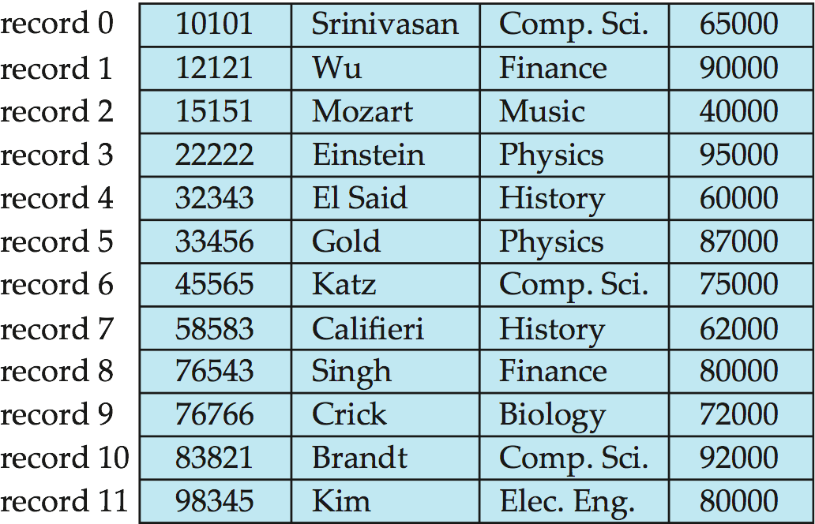
Fixed-Length Records
Simple approach
File of Instructor records stores
(ID varchar(5), name varchar(20), dept_name varchar(20), salary numeric (8,2))
Character occupies 1 byte and numeric(8,2) 8 bytes
Total 1 record size is 53 bytes
Notes:
‹#›

Slide 65
Fixed-Length Records
Simple approach
Two problems
Block size happens to be a multiple of record size (example
)
It may cross the block boundaries
Solution
Allocate as many records to a block as would fit entirely in the block
Divide the block size by the record size, discard fraction part
Record access is simple
53B
11B
Notes:
‹#›

Slide 66
Fixed-Length Records
Difficult to delete a record
Solution
The space occupied by the record to be deleted must be filled with some other record of the file
1. Move records i + 1, . . ., n to i, . . . , n – 1
2. Move record n to i
Have a way of marking deleted records to ignore
3. Do not move records, but link all free records on a free list
Notes:
‹#›

Slide 67
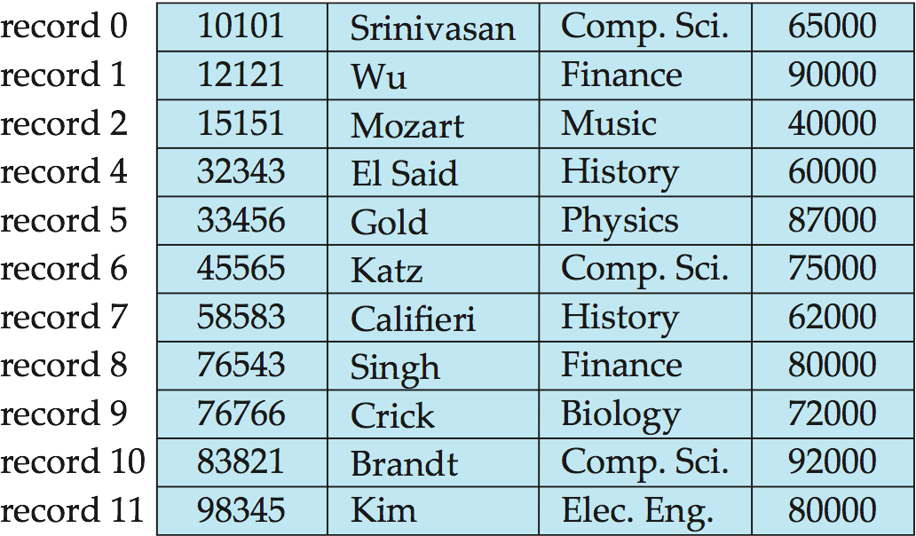
Deleting record 3 and compacting
Difficult as requires number of records to move, desirable to move the final record at the deleted record space
Notes:
‹#›

Slide 68
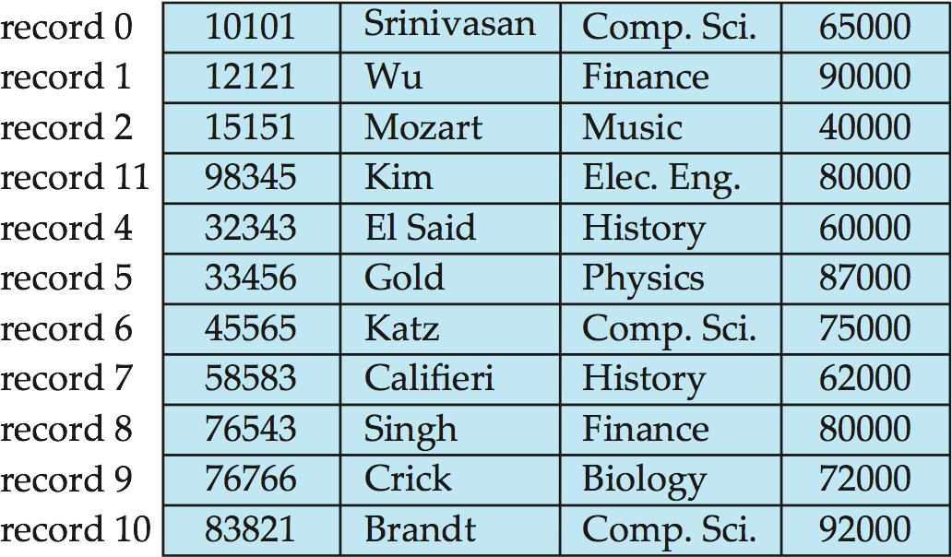
Deleting record 3 and moving last record
Also requires number of block access
Insertions tend to be more frequent than deletions, leave space open by the deleted record and to wait for a subsequent insertion
Notes:
‹#›

Slide 69
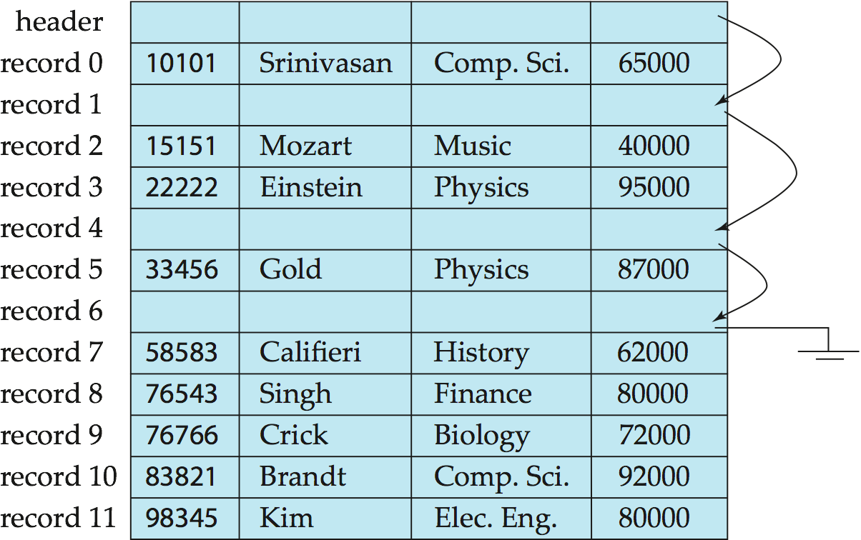
Free Lists
File Header, Additional structure is required to do so,
Contains variety of information about the file
Here, Store the address of the first deleted record in the file header
Use this first record to store the address of the second deleted record, and so on
Consider, stored addresses as pointers since they
“point” to the location of a record
Notes:
‹#›

Slide 70
Free Lists
On insertion of a new record
Use the record pointed by the header
Change the header pointer to point to the next available record
If no space is available, add the new record to the end of file
More space efficient representation and simple
As inserted and deleted record size is same
Notes:
‹#›

Slide 71
Variable-Length Records
Need of Variable-length records in database systems in several ways
Storage of multiple record types in a file
Record types that allow variable lengths for one or more fields such as strings (varchar)
Two problems to solve to use this technique
The way of representations of single record to extract individual attributes of the record
Storage of record within a block, such that records in a block can be extracted easily
Notes:
‹#›

Slide 72
Variable-Length Records
Variable length record has two parts
Initial part with fixed length attributes
E.g. Numeric values, dates or fixed length character string
Followed by data for variable length attributes
E.g. Varchar types
Solution
Attributes are stored in order
Variable length attributes represented by fixed size (offset, length), with actual data stored after all fixed length attributes
Utilizes Null Bitmap
Notes:
‹#›

Slide 73
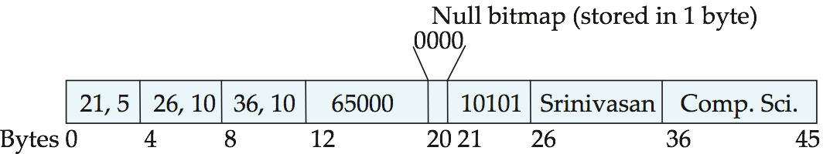
Variable-Length Records
Utilizes Null Bitmap
Indicates which attributes of the record has a Null value
Use 1 byte to indicate null value
Ignore the bytes stored at the offset
Sometimes stored at the beginning of the record
Not storing data (value, offset/length) at all
Save storage space, at the cost of extra work to extract
(ID varchar(5), name varchar(10), dept_name varchar(10), salary numeric (8,2))
Notes:
‹#›

Slide 74
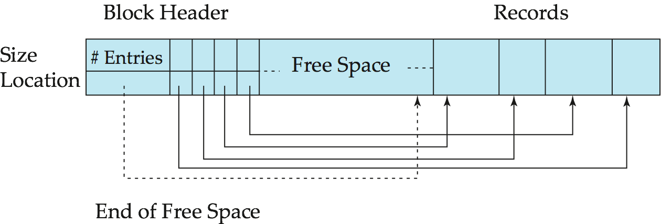
Variable-Length Records: Storage
Utilizes slotted page structure
Slotted page header contains
Number of record entries
End of free space in the block
Location and size of each record
The actual records are allocated contiguously in the block, starting from the end of the block
The free space in the block is contiguous, between the final entry in the header array and the first record
Notes:
‹#›

Slide 75
Variable-Length Records: Slotted Page Structure
Record insertion
Space is allocated for it at the end of the free space
An entry containing its size and location is added to the header
Record deletion
The occupied space is freed and its entry is set to deleted
Records can be moved around within a page to keep them contiguous with no empty space between them; entry in the header must be updated
Notes:
‹#›

Slide 76
Variable-Length Records: Slotted Page Structure
Pointers should not point directly to record — instead they should point to the entry for the record in header
Prevents fragmentation of space inside the block
Notes:
‹#›

Slide 77
Organization of Records in Files
Discussed how records are represented in a file structure on external storage
But, relation is a set of records
How to ORGANIZE RECORDS IN A FILE
Records of each relation stored in a separate file
Heap File Organization
Sequential File Organization
Hashing File Organization
Records of several relations stored in one file
Multitable clustering file organization
Notes:
‹#›

Slide 78
Organization of Records in Files
Heap File Organization
Any record can be placed anywhere in the file where there is space
No ordering of records is required
Unordered file organization
Simplest type of file organization
Single file for each relation
Notes:
‹#›

Slide 79
Organization of Records in Files
Heap File Organization
Record Insertion
Placed in file in the same order as they are inserted
New record is inserted in the last page of the file; if there is insufficient space in the last page, a new page is added to the file. This makes insertion very efficient.
Record Access
Heap file has no particular ordering with respect to field values, a linear search must be performed to access a record. A linear search involves reading pages from the file until the required is found. This makes retrievals from heap files that relatively slow.
Notes:
‹#›

Slide 80
Organization of Records in Files
Heap File Organization
Record Deletion
The required page first has to be retrieved, the record marked as deleted, and the page written back to disk.
The space with deleted records is not reused.
Consequently, performance progressively deteriorates as deletion occurs. This means that heap files have to be periodically reorganized by the Database Administrator (DBA) to reclaim the unused space of deleted records
Heap files are one of the best organizations for bulk loading data into a table, as records are inserted at the end of the sequence; there is no overhead of calculating what page the record should go on.
Notes:
‹#›

Slide 81
Organization of Records in Files
Heap File Organization
Advantageous
When data is being bulk-loaded into the relation
The relation is only a few pages long. In this case, the time to locate any tuple is Short, even if the entire relation has been searched serially.
When every tuple in the relation has to be retrieved (in any order) every time the relation is accessed. For example, retrieve the name of all the students.
Disadvantageous
Heap files are inappropriate when only selected tuples of a relation are to be accessed.
Notes:
‹#›

Slide 82
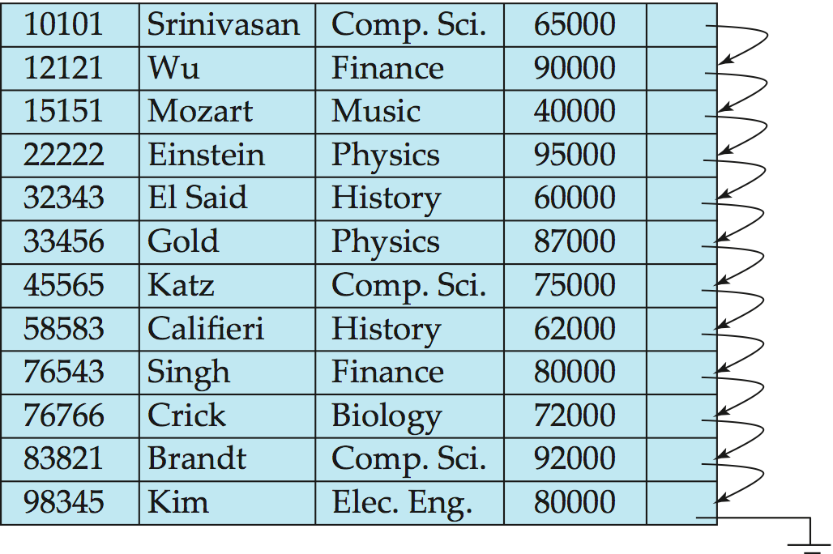
Sequential File Organization
Suitable for applications that require sequential processing of the entire file
Mainly display purposes as well as for certain query processing algorithm
Search-key
Sorted the records in the file, ordered by this key which is Any attribute or set of attributes and not the primary key, or even a super-key
Chain together records by pointer for fast retrieval of records
Sequential file with
ID as search key
Notes:
‹#›

Slide 83
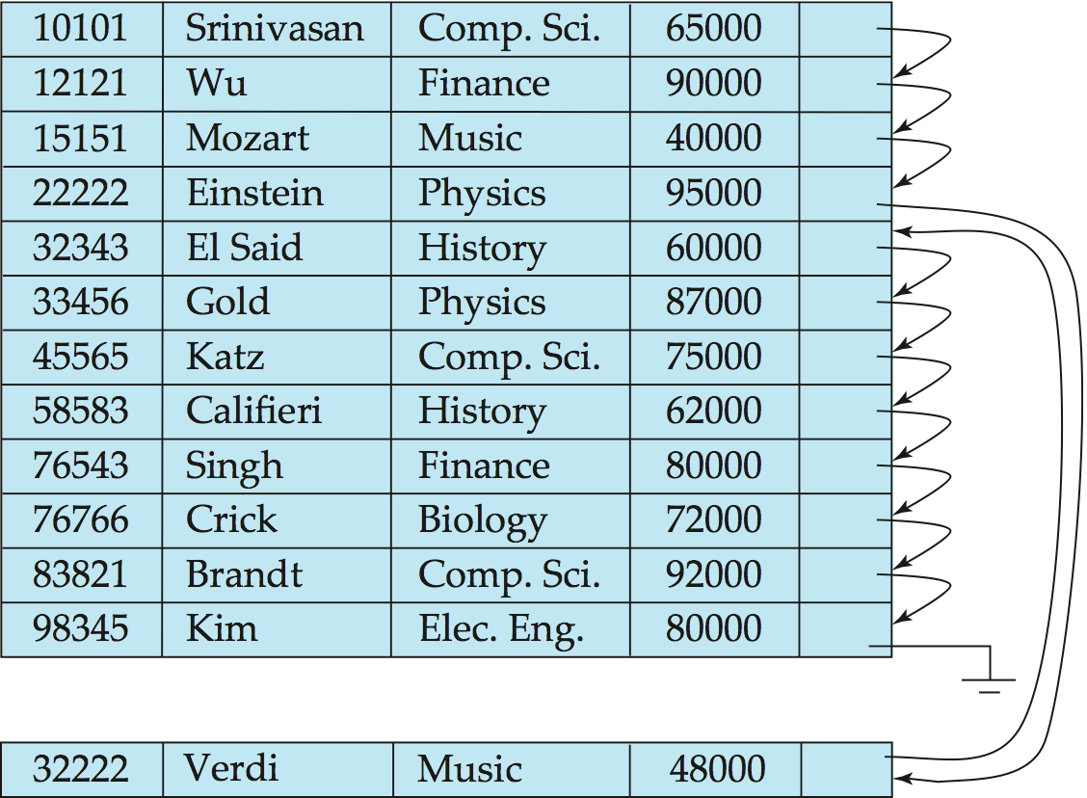
Sequential File Organization (Cont.)
Record Insertion –Locate the position where the record is to be inserted
If there is free space insert there
If no free space, insert the record in an overflow block
In either case, pointer chain must be updated
Works well
If relatively few records
stored in overflow block
Need to reorganize the file from time to time to restore sequential order
Notes:
‹#›

Slide 84
Organization of Records in Files
Sequential File Organization
Record Insertion
New record is always inserted at the file's end, and then it will sort the sequence in ascending or descending order. Sorting of records is based on any primary key or any other key
Record Access
Accessed in sequential order
Records can be read in sequential order. For reading the 10th record, all the previous 9 records should be read.
Record Updation
Update the record and then sort the file, and lastly, the updated record is placed in the right place.
Record Deletion
Uses pointer chains
Notes:
‹#›

Slide 85
Organization of Records in Files
Sequential File Organization
Advantages
Fast and efficient method for the huge amount of data
Files can be easily stored in cheaper storage mechanism like magnetic tapes
Simple in design. It requires no much effort to store the data
Used when most of the records have to be accessed like grade calculation of a student, generating the salary slip, etc.
Used for report generation or statistical calculations or for printing
Notes:
‹#›

Slide 86
Organization of Records in Files
Sequential File Organization
Disadvantages
It will waste time as we cannot jump on a particular record that is required but we have to move sequentially which takes our time
Sorted file method takes more time and space for sorting the records
Notes:
‹#›

Slide 87
Organization of Records in Files
Hash File Organization
Records are not stored sequentially in a file
A hash function computed on some attribute of each record; the result specifies in which block of the file the record should be placed
The field on which hash function is calculated is called as Hash field and if that field acts as the key of the relation then it is called as Hash key
Records are randomly distributed in the file so it is also called as Random or Direct files. Commonly some arithmetic function is applied to the hash field so that records will be evenly distributed throughout the file.
Notes:
‹#›

Slide 88
Organization of Records in Files
Hash File Organization
Advantageous
When tuples are retrieve based on an exact match on the hash field value, particularly if the access order is random. For example, if the STUDENT relation is hashed on Name then retrieval of the tuple with Name equal to “Simran” is efficient
Disadvantageous
When tuples are retrieved based on
Range of values for the hash field: For example, retrieve all students whose name begins with the “S”
Range of values for the hash field: For example, if STUDENT relation has hash filed Roll Number and the query is to retrieve all students with roll numbers in the range of 3000-5000.
Notes:
‹#›

Slide 89
Organization of Records in Files
Hash File Organization
Disadvantageous
When tuples are retrieved based on
Field other than the hash field: For example, if the STUDENT relation is hashed on Roll Number, then hashing cannot be used to search for a tuple based on the Class attribute.
Only part of the hash field. For example, if the STUDENT relation is hashed on Roll Number and Class, then hashing cannot be used to search for a tuple based on the class attribute alone
When the hash field frequently updated. When a hash field updated, the DBMS must deleted the entire tuple and possible relocate it to a new address (if the has function results in a new address). Thus, frequent updating of the hash field impacts performance.
Notes:
‹#›

Slide 90
Organization of Records in Files
Multitable Clustering File Organization
Records of several different relations can be stored in the same file
Motivation
Store related records on the same block to minimize I/O
To reduce I/O operations
Notes:
‹#›

Slide 91
Multitable Clustering File Organization
Beneficiary, If database size is large
Instead of be dependent upon OS, DBMS manages this file
Store several relations in one file
But, records of one relation stores in a given block
Simplifies data management
Sometimes, beneficiary if storing records of multiple relations in one block
Notes:
‹#›

Slide 92
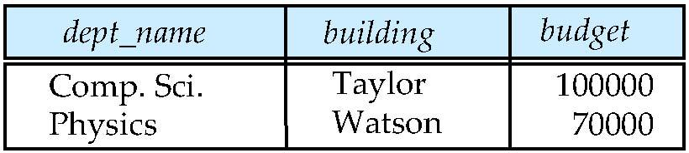
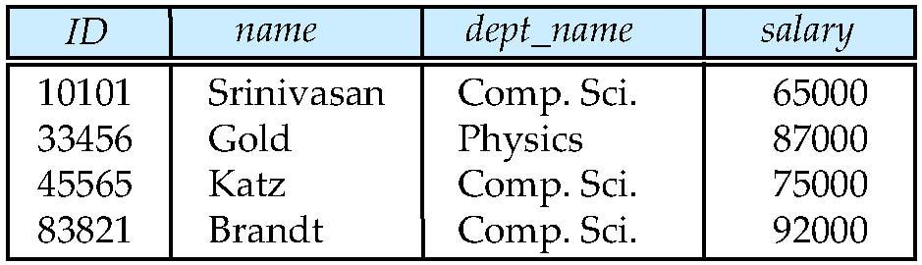
Multitable Clustering File Organization
Join on Department and Instructor table
System must locate the instructor tuples with the same value for dept_name
Utilization of Indices to locate the record (See later)
Records have to be transferred from disk into main memory
Worst Case: each record reside on a different block, forcing one block read for each record
department
instructor
Notes:
‹#›

Slide 93
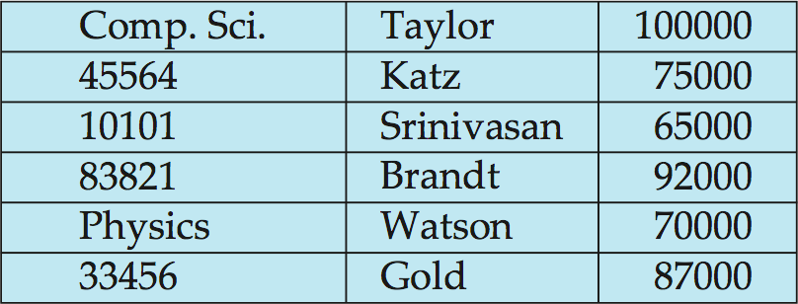
Multitable Clustering File Organization
Join on Department and Instructor table
Mixes together tuples of two relations for efficient processing
When department tuple is read, the entire block containing that tuple is copied from disk to main memory
department
instructor
Multitable clustering of
department and
Instructor
No dept_name for instructors
Followed by department tuple
Notes:
‹#›

Slide 94
Multitable Clustering File Organization
Join on Department and Instructor table
Efficient query processing
Utilizes nearby blocks if records do not fit in one block
department
instructor
Multitable clustering
of department and
instructor
Notes:
‹#›

Slide 95
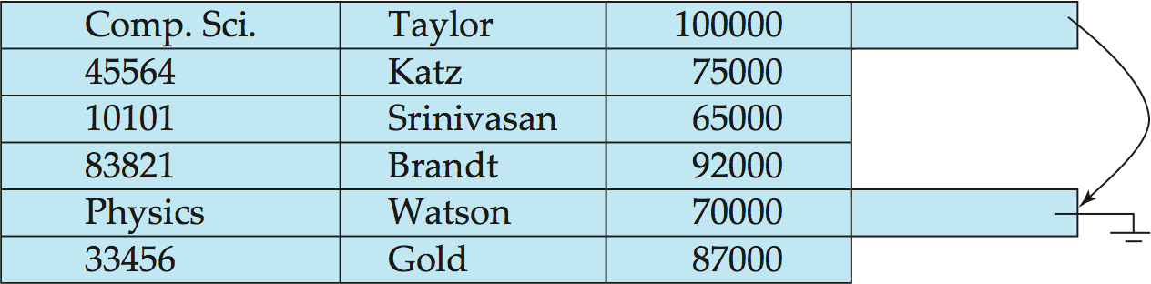
Multitable Clustering File Organization (cont.)
Requires careful use
Good for queries involving department instructor, and for queries involving one single department and its instructors
Bad for queries involving only department, slows down execution
Results in more block access
Can add pointer chains to link records of a particular relation

Slide 96
DBMS Cluster File Organization – javatpoint
What is File Organizations? Types of File Organization. - Computer Notes (ecom
COBOL - File Organization (tutorialspoint.com)
File Storage and Indexing (neu.edu)File Storage and Indexing (neu.edu)puternotes.com)

Slide 97
Data Dictionary Storage
Discussed only representation of the relations
Requires to maintain data about the relations-data about data (METADATA)
Data dictionary (System Catalog)
Stores metadata; that is, data about data, such as
User and accounting information, including passwords
Information about relations
Names of relations
Names, types and lengths of attributes of each relation
Names and definitions of views
Integrity constraints
Statistical and descriptive data
Number of tuples in each relation
Physical file organization information
How relation is stored (sequential/hash/…)
Physical location of relation
Information about indices (Chapter 11)
Notes:
‹#›

Slide 98
Data Dictionary Storage
Metadata
Constitutes miniature database
Stored using special purpose data structure and code
As relations in the database itself
Made by the system designers
Whenever the database system needs to retrieve records from a relation
First consult the Relation_metadata relation to find the location and storage organization of the relation
Then fetch records using this information
Notes:
‹#›

Slide 99
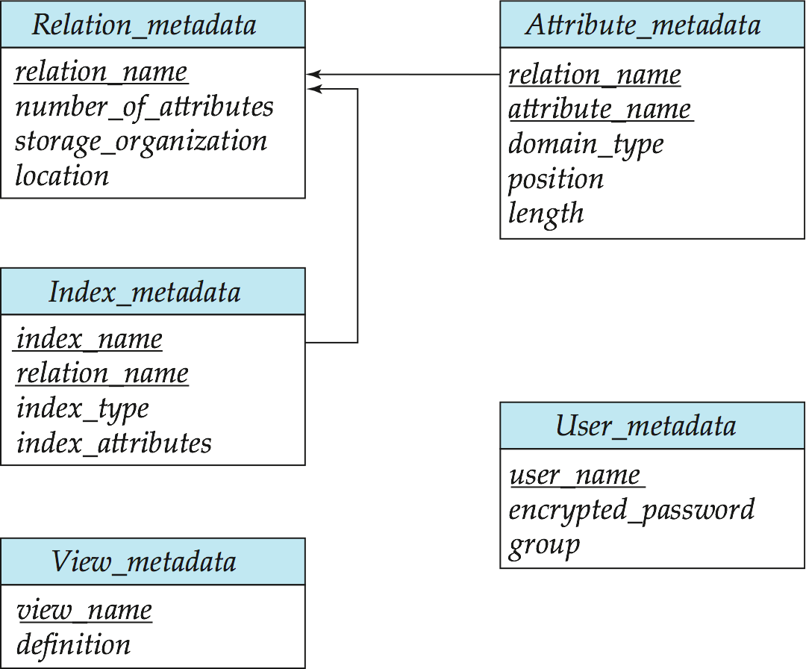
Relational Representation of System Metadata
Relational representation on disk
Specialized data structures designed for efficient access, in memory
Approach
Stored in a nonnormalized form to achieve fast access
Attribute index_attributes of the relation Index_metadata assumed to contain a list of one or more attributes

Slide 100
Storage Access
Blocks
A database file is partitioned into fixed-length storage units
Units of both storage allocation and data transfer
Database system seeks to minimize the number of block transfers between the disk and memory
Can be reduced the number of disk accesses by keeping as many blocks as possible in main memory
Buffer – Portion of main memory available to store copies of disk blocks
Buffer manager – Subsystem responsible for allocating buffer space in main memory
Notes:
‹#›

Slide 101
Buffer Manager
Programs call on the buffer manager when they need a block from disk
If the block is already in the buffer, buffer manager returns the address of the block in main memory
If the block is not in the buffer, the buffer manager
Allocates space in the buffer for the block
Replacing (throwing out) some other block, if required, to make space for the new block
Replaced block written back to disk only if it was modified since the most recent time that it was written to/fetched from the disk
Reads the block from the disk to the buffer, and returns the address of the block in main memory to requester
Notes:
‹#›

Slide 102
Buffer Manager
Just like Virtual memory manager found in OS
Difference is that the size of the database might be larger than the hardware address space of a machine, so memory addresses are not sufficient to address all disk blocks
Utilizes techniques more sophisticated than typical VM management schemes
Buffer Replacement Policies
Least Recently Used (LRU)
Toss-Immediate
Most Recently Used
Pinned blocks
Forced output of blocks
Notes:
‹#›

Slide 103
Buffer-Replacement Policies
To minimize access to the disk
In general-purpose program, not possible to predict accurately which blocks will be referenced
Queries have well-defined access patterns (such as sequential scans), and a database system can use the information in a user’s query to predict future references
Notes:
‹#›

Slide 104
Buffer-Replacement Policies
1.1 LRU strategy
Idea behind LRU – OS uses past pattern of block references as a predictor of future references
The blocks that have been referenced recently are likely to be referenced again
Most OSs replace the block least recently used to disk
When there is no room left in buffer, a block must be removed from the buffer before a new one can be read in
Notes:
‹#›

Slide 105
Buffer-Replacement Policies (Cont.)
Pinned block
Memory block that is not allowed to be written back to disk
As block should not be written to disk while an update on the block is in progress
Many OS does not support pinned blocks as durable to crash
Forced output of blocks
Write situations, in which it is necessary to write back the block to disk, even though the buffer space that it occupies is not needed, it is for the purpose of recovery (See later in Ch. 16 Recovery Algorithm)
Notes:
‹#›

Slide 106
Buffer-Replacement Policies
1.2 Toss-immediate Strategy
Frees the space occupied by a block as soon as the final tuple of that block has been processed
Example Query: Select * from instructor natural join department
Strategy:
for each tuple tr of Instructor do for each tuple ts of department do if the tuples tr and ts match …
If these two relations stored in separate files, once a tuple of the instructor has been processed, that tuple is not needed in main memory, even though it has been used recently
Notes:
‹#›

Slide 107
Buffer-Replacement Policies
1.3 Most Recently Used Strategy
Example Query: Select * from instructor natural join department
Strategy:
for each tuple tr of Instructor do for each tuple ts of department do if the tuples tr and ts match …
Need to examine every block of department tuples once for each tuple of the instructor relation
Processing of department block is completed, we know that block will not be accessed again until all other department blocks have been processed
Most recently used department block will be the final block to be re-referenced
Least recently used department block is the block that will be referenced next
Optimal strategy for this query
Notes:
‹#›

Slide 108
Buffer-Replacement Policies
1.3 Most recently used (MRU) strategy (Cont.)
System must pin the block currently being processed
After the final tuple of that block has been processed, the block is unpinned, and it becomes the most recently used block
Buffer manager can use statistical information regarding the probability that a request will reference a particular relation
E.g., The data dictionary is frequently accessed
Heuristic: keep data-dictionary blocks in main memory buffer
Notes:
‹#›

Slide 109
Buffer-Replacement Policies
Policies Summary
No single strategy is known that handles all the possible scenarios well
Large no. of DBMSs use LRU, even though it fails
Mixed strategy influenced by factors
If the system is processing requests by several users concurrently, the Concurrency control subsystem (Ch. 15) need to delay certain requests to preserve database consistency
Alter the block replacement strategy, blocks needed by active (non-delayed) requests can be retained in the buffer at the expense of blocks needed by the delayed requests
Notes:
‹#›

Slide 110
Buffer-Replacement Policies
Policies Summary
Mixed strategy influenced by factors
The crash-recovery subsystem imposes that,
If the block has been modified, the buffer manager is not allowed to write back the new version of the block in the buffer to disk, since that would destroy the old version
Permission to set from crash-recovery to buffer manager before writing out a block
Certain blocks be forced-output
Notes:
‹#›

Slide 111
End of Chapter 10
Notes:
‹#›

